Slide 1




Slide 2

Outline
Introduction Customer Churn
Customer Churn Prediction using Machine Learning
Imbalanced Data
Handling Imbalanced Data

Slide 3

Introduction Customer Churn

Slide 4

Customer Churn
Churn rate (also called attrition rate) measures the number of individuals or items moving out of a collective group over a specific period. It applies in many contexts, but the mainstream understanding of churn rate is related to the business case of customers that stop buying from you.
The impact of the churn rate is clear, so we need strategies to reduce it. Predicting churn is a good way to create proactive marketing campaigns targeted at the customers that are about to churn.
Thanks to big data, forecasting customer churn with the help of machine learning is possible. Machine learning and data analysis are powerful ways to identify and predict churn. During churn prediction, you’re also:
Identifying at-risk customers,
Identifying customer pain points,
Identifying strategy/methods to lower churn and increase customer retention.

Slide 5
Why is it so important?
Customer churn is a common problem across businesses in many sectors. If you want to grow as a company, you have to invest in acquiring new clients. Every time a client leaves, it represents a significant investment lost. Both time and effort need to be channelled into replacing them. Being able to predict when a client is likely to leave, and offer them incentives to stay, can offer huge savings to a business.
As a result, understanding what keeps customers engaged is extremely valuable knowledge, as it can help you to develop your retention strategies, and to roll out operational practices aimed at keeping customers from walking out the door.
Predicting churn is a fact of life for any subscription business, and even slight fluctuations in churn can have a significant impact on your bottom line. We need to know: “Is this customer going to leave us within X months?” Yes or No? It is a binary classification task.

Slide 6

Challenges of Building an Effective Churn Model
Inaccurate or messy customer data,
Weak attrition exploratory analysis,
Lack of information and domain knowledge,
Lack of a coherent selection of a suitable churn modeling approach,
Choice of metrics to validate churn model performance,
Line of business (LoB) of services or products,
Churn event censorship,
Concept drift based on changes in customers behaviour patterns driving churn,
Imbalance data (class imbalance issue).

Slide 7

Churn Prediction Use Cases
Telecommunication (cable or wireless network segment)
Software as a service provider (SaaS)
Retail market
Subscription-based businesses (media, music and video streaming services, etc.)
Financial institutions (banking, insurance companies, Mortgage Companies, etc.)
Marketing
Human Resource Management (Employee turnover)

Slide 8
Designing churn prediction workflow
Defining problem and goal: It’s essential to understand what insights you need to get from the analysis and prediction. Understand the problem and collect requirements, stakeholder pain points, and expectations.
Establishing data source: Next, specify data sources that will be necessary for the modeling stage. Some popular sources of churn data are CRM systems, analytics services, and customer feedback.
Data preparation, exploration, and preprocessing: Raw historical data for solving the problem and building predictive models needs to be transformed into a format suitable for machine learning algorithms. This step can also improve overall results by increasing the quality of data.
Modeling and testing: This covers the development and performance validation of customers churn prediction models with various machine learning algorithms.
Deployment and monitoring: This is the last stage in applying machine learning for churn rate prediction. Here, the most suitable model is sent into production. It can be either integrated into existing software, or become the core of a newly built application.

Slide 9
Customer Churn Prediction using Machine Learning

Slide 10
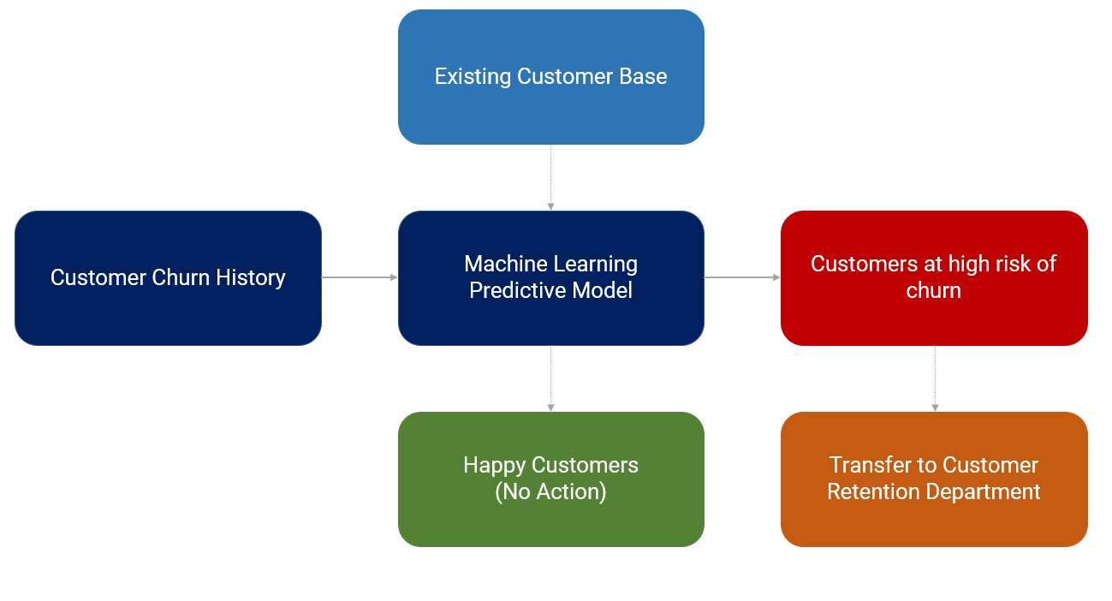
Customer Churn Model Workflow
A model is trained on customer churn history (event period for X features and performance window for target variable).
Every month active customer base is passed onto Machine Learning Predictive Model to return the probability of churn for each customer (in business lingo, this is sometimes called a score of churn).
The list will be sorted from highest to lowest probability value (or score as they say it) and the customer retention teams will start engaging with the customer to stop the churn, normally by offering some kind of promotion or gift card to lock in few more years.
Customers that have a very low probability of churn (or essentially model predicts no-churn) are happy customers. No actions are taken on them.

Slide 11
Imbalanced Dataset

Slide 12
So, what is Imbalanced Dataset? And what effect does it have for the model?
Often we get data about customer churn with very few churn cases in a product or company. The proportion of churn and non-churn customers can go to extreme numbers (eg "95% vs 5%" or "99% vs 1%"). This kind of data is what we call an imbalanced dataset.

Slide 13
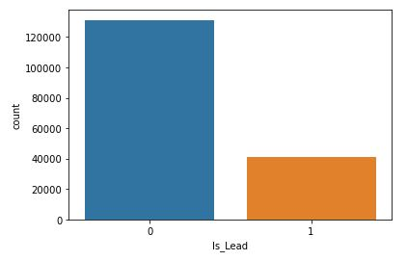
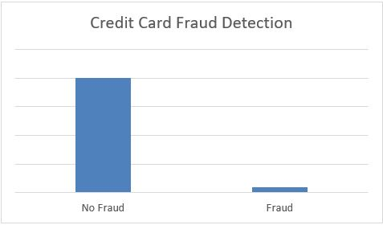
What is imbalanced data?
Imbalanced data refers to those types of datasets where the target class has an uneven distribution of observations, i.e one class label has a very high number of observations and the other has a very low number of observations.

Slide 14
Handling Imbalanced Dataset

Slide 15
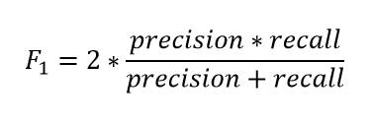
Choose Proper Evaluation Metric
The accuracy of a classifier is the total number of correct predictions by the classifier divided by the total number of predictions. This may be good enough for a well-balanced class but not ideal for the imbalanced class problem. The other metrics such as precision is the measure of how accurate the classifier’s prediction of a specific class and recall is the measure of the classifier’s ability to identify a class.
For an imbalanced class dataset F1 score is a more appropriate metric. It is the harmonic mean of precision and recall and the expression is –

Slide 16
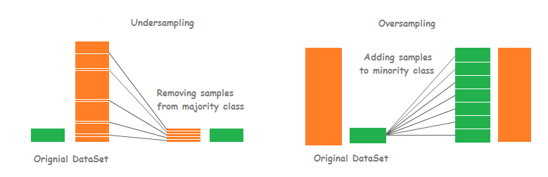
Resample the training set
Under-sampling
Under-sampling balances the dataset by reducing the size of the abundant class. This method is used when quantity of data is sufficient. By keeping all samples in the rare class and randomly selecting an equal number of samples in the abundant class, a balanced new dataset can be retrieved for further modelling.
Over-sampling
On the contrary, oversampling is used when the quantity of data is insufficient. It tries to balance dataset by increasing the size of rare samples. Rather than getting rid of abundant samples, new rare samples are generated by using e.g. repetition, bootstrapping or SMOTE (Synthetic Minority Over-Sampling Technique).
Note that there is no absolute advantage of one resampling method over another. Application of these two methods depends on the use case it applies to and the dataset itself. A combination of over- and under-sampling is often successful as well.
reference : https://arxiv.org/pdf/1106.1813.pdf

Slide 17
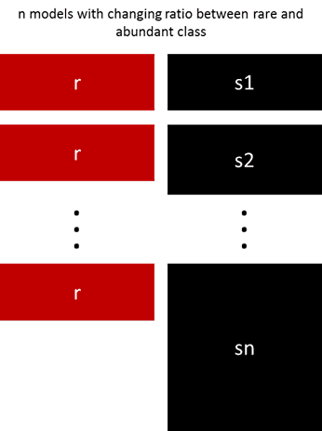
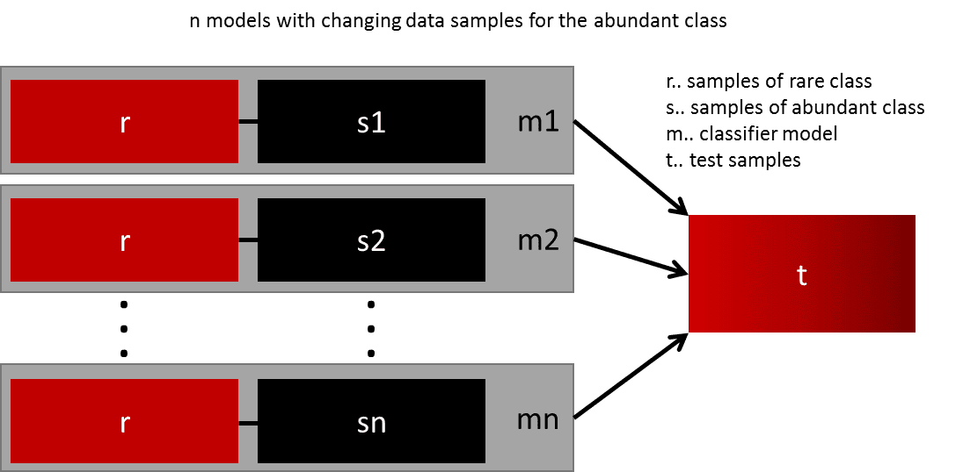
Ensemble different resampled datasets
Resample with different ratios

Slide 18
Cluster the abundant class
An elegant approach was proposed by Sergey on Quora. Instead of relying on random samples to cover the variety of the training samples, he suggests clustering the abundant class in r groups, with r being the number of cases in r. For each group, only the medoid (centre of cluster) is kept. The model is then trained with the rare class and the medoids only.
reference: : https://www.quora.com/In-classification-how-do-you-handle-an-unbalanced-training-set/answers/1144228?srid=h3G6o

Slide 19
Design your own models
All the previous methods focus on the data and keep the models as a fixed component. But in fact, there is no need to resample the data if the model is suited for imbalanced data. The famous XGBoost is already a good starting point if the classes are not skewed too much, because it internally takes care that the bags it trains on are not imbalanced. But then again, the data is resampled, it is just happening secretly.
By designing a cost function that is penalizing wrong classification of the rare class more than wrong classifications of the abundant class, it is possible to design many models that naturally generalize in favour of the rare class. For example, tweaking an SVM to penalize wrong classifications of the rare class by the same ratio that this class is underrepresented.

Slide 20
